Slide 2
Example
Nautilus has indicated that it needs $1.5 billion in funding to continue ramping up its international expansion efforts and for general corporate purposes
Management has indicated a strong preference for Unsecured Senior Notes, but we believe that Convertible Bonds offer the lowest cost of funding, and that dilution can be minimized with the proper call-spread structure
Such Convertible Bonds might offer a 45% conversion premium (conversion price of $641.58) and a 1.5% coupon rate, for an after-tax cash cost of 0.99%
By contrast, the after-tax cost of Unsecured Senior Notes might be between 3.50% and 4.00%, and such an issuance would likely result in a credit rating downgrade for Nautilus
Given Nautilus’ share price and valuation multiples, a follow-on equity offering is also viable, but the likely discount on such an offering would imply an after-tax cost of between 1.20% and 1.40%. Nautilus has indicated that it needs $1.5 billion in funding to continue ramping up its international expansion efforts and for general corporate purposes
Management has indicated a strong preference for Unsecured Senior Notes, but we believe that Convertible Bonds offer the lowest cost of funding, and that dilution can be minimized with the proper call-spread
Such Convertible Bonds might offer a 45% conversion premium (conversion price of $641.58) and a 1.5% coupon rate, for an after-tax cash cost of 0.99%
By contrast, the after-tax cost of Unsecured Senior Notes might be between 3.50% and 4.00%, and such an issuance would likely result in a credit rating downgrade for Nautilus
Given Nautilus’ share price and valuation multiples, a follow-on equity offering is also viable, but the likely discount on such an offering would imply an after-tax cost of between 1.20% and 1.40%
Example
Nautilus has indicated that it needs $1.5 billion in funding to continue ramping up its international expansion efforts and for general corporate purposes. Management has indicated a strong preference for Unsecured Senior Notes, but we believe that Convertible Bonds offer the lowest cost of funding, and that dilution can be minimized with the proper call-spread structure

Slide 3
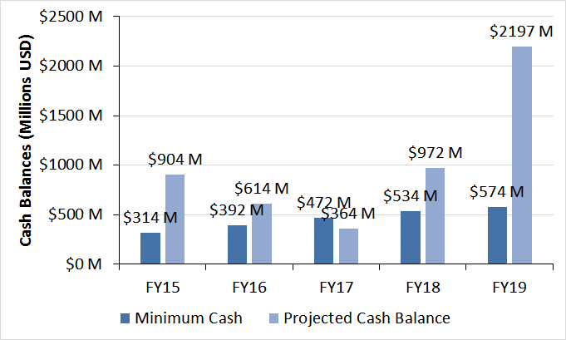
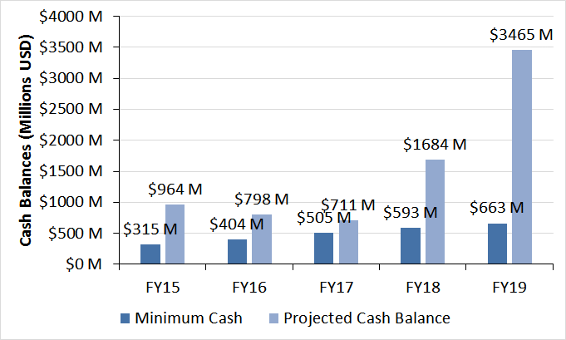
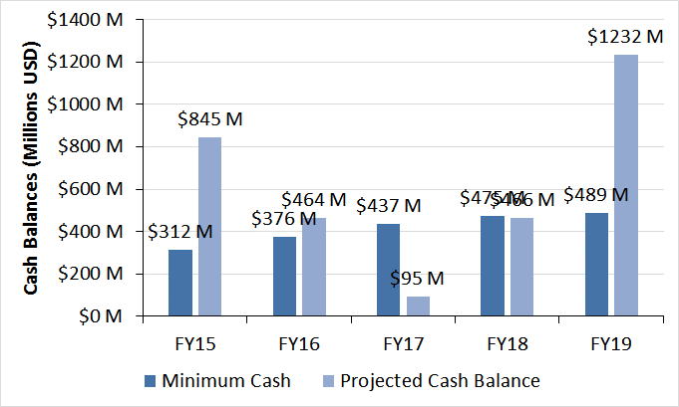
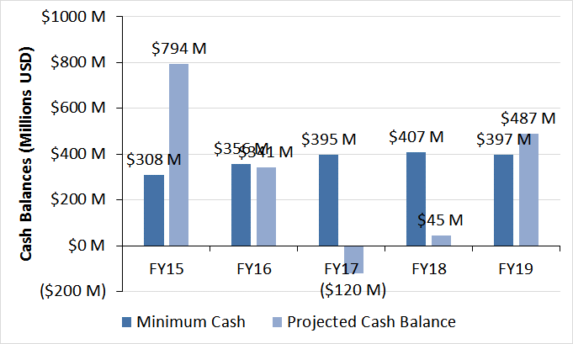
Nautilus’ Financials
To evaluate Nautilus’ financial performance from the perspective of debt and equity investors, Goldman Stanley projected its financial statements under four scenarios:
Base Case: This scenario was in-line with consensus estimates for the company
Upside Case: This scenario aligned more closely with internal projections provided by management
Downside Case: This case corresponded to lower subscriber growth, renewal rates, and fee growth, and higher marketing expenses and cost of revenue
Extreme Downside Case: Subscriber growth and fee growth were significantly lower in this case; marketing expenses and cost of revenue were even higher as percentages of revenue
Despite the differences, many of the key percentage-based assumptions were the same across all scenarios:
Domestic Content Additions and Amortization: Content additions were set to 60% of FY 15 domestic streaming revenue, falling to 35% by FY 19, with amortization of 25-35% in FY 15 declining to 5-10% in FY 19
Content additions were set to 110% of international streaming revenue in FY 15, falling to 70% by FY 19, with amortization of 35-50% in FY 15 declining to 0-5% in FY 19
Financing Requirements
Under the assumption that the Nautilus minimum cash balance is 5% of its Cost of Revenue + Operating Expenses, the company requires additional funding in every scenario except for the Upside Case.
Base Case
Upside Case
Downside Case
Extreme Downside Case

Slide 4
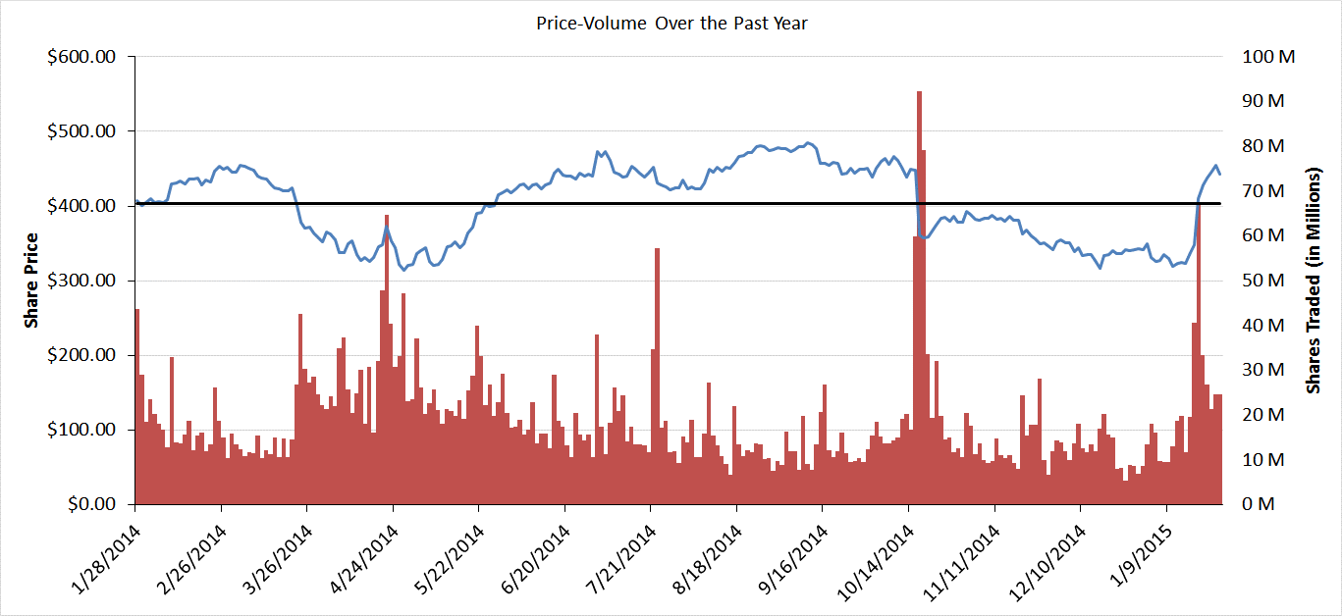
Rationale for Follow-On Equity Offering
Given Nautilus’ rich valuation multiples and stock-price performance in the past several years, it is a prime candidate for a follow-on equity offering
Because of the recent jump in the stock price, we believe the company may have to offer a higher-than-usual share-price discount to complete a $1.5 billion follow-on offering
At discounts of 10-20%, the company’s After-Tax Cost of Equity ranges from 1.24% to 1.38% in the Base Case (1.60% to 1.80% in the Upside Case and 0.85% to 0.95% in the Downside Case)
($ USD in Millions Except for $ per Share Figures)
Average Share Price - $403.53

Slide 5
Valuation Summary
#1
Nautilus’ Share Price Exceeds its Intrinsic Value
The company’s share price is a 15% premium to its DCF-determined intrinsic value in the Base Case and 42% in the Downside Case (vs. a 30% discount in the Upside Case)
#2
Nautilus Trades at Premium Multiples
Despite EBITDA growth in the middle of the public comps’ range, Nautilus trades at, by far, the highest EV / EBITDA and P / E multiples, exceeding even those of Facebook
#3
Nautilus’ Share Price is Up ~10% in the Past Year
While this is not a tremendous increase, equity investors may still perceive the company as being richly valued, given the recent price jump and the resulting multiples
#4
But Its Share Price is Up More Than 6x in the Past Five Years
Given the company’s longer-term trading history, investors are likely to demand a follow-on offering discount above the standard range

Slide 6
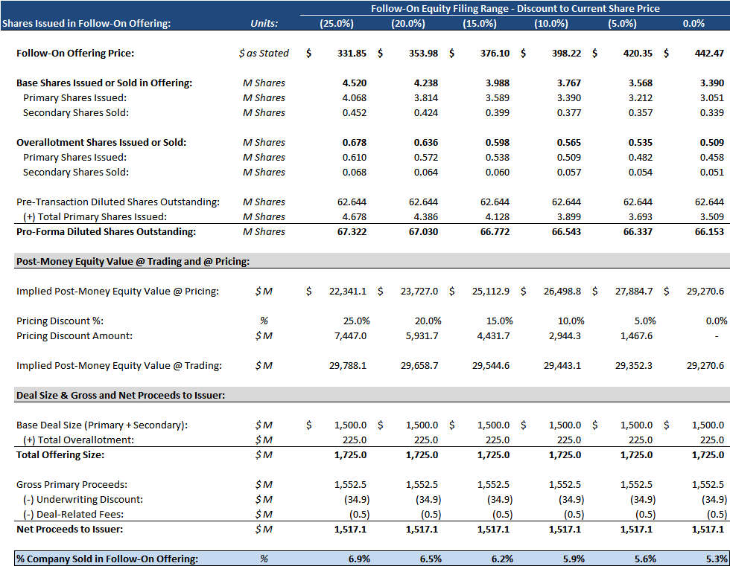
Follow-On Offering Proceeds Analysis
To analyze a potential follow-on offering, Goldman Stanley used the following assumptions:
Offering Size: $1.5 billion USD, with a 15% overallotment provision
Primary / Secondary Split: 90% / 10% in both the initial offering and the overallotment
Underwriting Discount: 2.25%
Other Fees: $0.5 million
($ USD in Millions Except for $ per Share Figures)

Slide 7
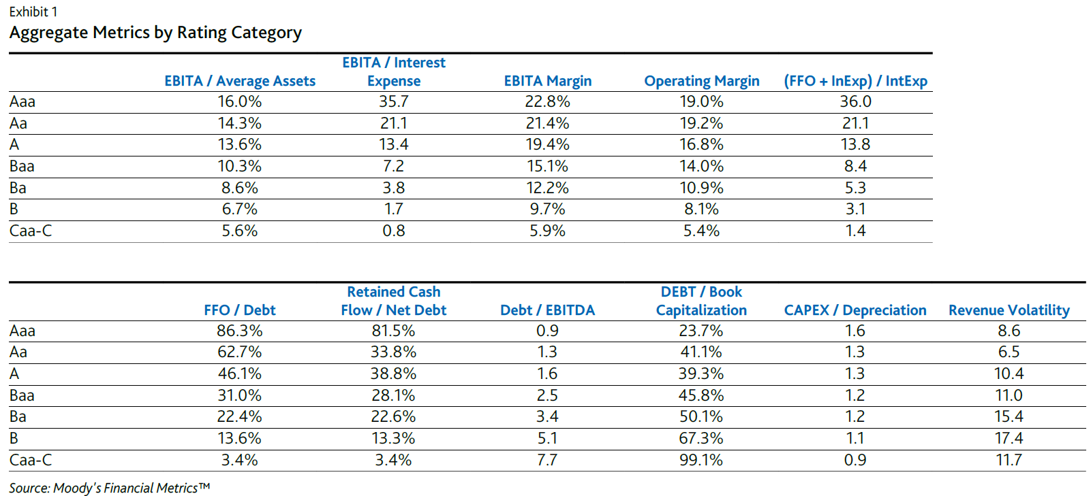
Comparable Debt Issuances
Goldman Stanley examined 126 debt issuances from U.S.-based “non-investment grade speculative” companies in the software and media industries; the average coupon rate was 5.38% with a tenor of 8.3 years
Moody’s has reported the following median Debt / EBITDA and EBITA / Interest for a broader set of BB-rated companies across all industries (note that the Moody’s “Ba” rating is equivalent to the Fitch and S&P “BB” rating):

Slide 8
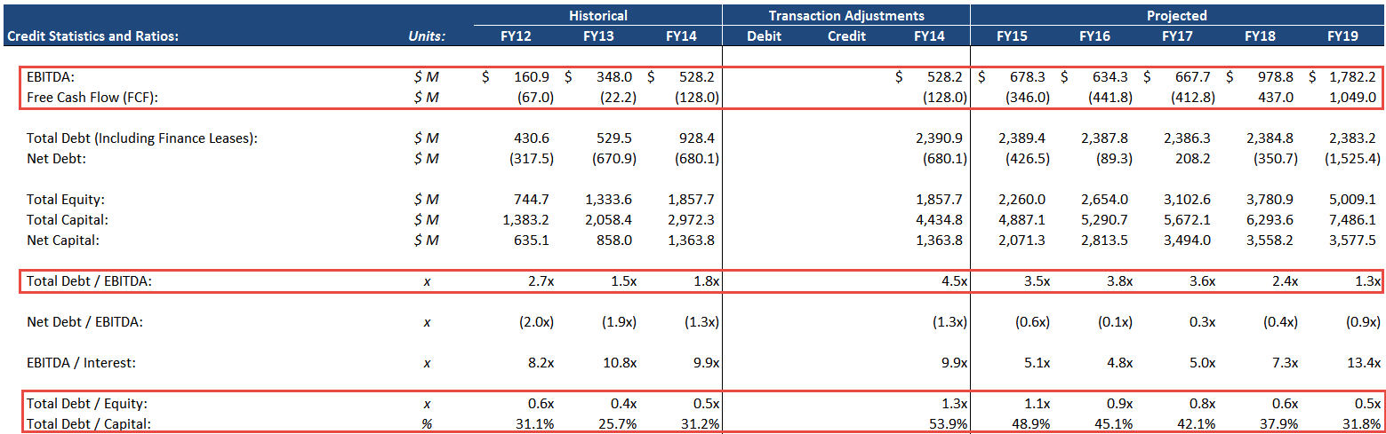
Pro-Forma Credit Statistics and Ratios – Base Case
Immediately after raising $1.5 billion, Nautilus’ Debt / EBITDA would jump from 1.8x to 4.5x, putting it in-line with B or B+-rated companies:
While the company would still have strong liquidity and interest coverage, its leverage and capital ratios would concern lenders and might trigger a credit rating downgrade
Additionally, lenders may view the company’s EBITDA and FCF projections with skepticism, given the “hockey stick” turnaround planned for FY 18 and FY 19
However, the real problem is that the figures look significantly worse in the Downside scenario (Debt/EBITDA rises to over 10x), which lenders focus on when assessing the company’s prospects
($ USD in Millions Except for $ per Share Figures)

Slide 9
Unsecured Senior Note Issuance – Conclusions
#1
Currently, Nautilus’ Credit Stats and Ratios Are Healthy
The company would likely be able to raise $1.5 billion in debt in two tranches of $750 million each, with coupon rates of 5.5% and 5.8% and tenors of 8 years; these figures are consistent with those of BB- technology companies
#2
Nautilus’ Credit Rating Would Likely Be Downgraded Afterward
The company’s pro-forma Debt / EBITDA would rise to 4.5x, putting it more in-line with B and B+-rated companies; lenders would also question its cash flow profile and margins
#3
Unsecured Senior Notes Would Reduce WACC
Since the company’s Cost of Equity as determined by CAPM is 9 – 14%, Unsecured Notes could offer a significantly lower cost and therefore reduce the company’s WACC
#4
A Debt Issuance Would Also Reduce Nautilus’ Financial Flexibility
At a leverage ratio of 4.5x, followed by 3.5x – 4.0x, it is unlikely that Nautilus could issue additional debt on the same terms; it would have to raise equity or more expensive debt, such as Subordinated Notes or Mezzanine

Slide 10
Rationale for a Convertible Bond Offering
A convertible bond offers many of the same advantages as plain-vanilla debt and equity offerings, but it comes without the disadvantages, or with diminished disadvantages:
Criterion | Follow-On Equity | Unsecured Senior Notes | Convertible Bond
After-Tax Cost of Funding | Moderate | Highest | Lowest
Impact on WACC | Increase | Moderate Decrease | Substantial Decrease
Share Price Impact | Neutral to Positive | Neutral | Neutral to Positive
Credit Rating Impact | None | Likely Downgrade | Possible Downgrade
Share Dilution | 6-7% | None | 4-5%, but possible to reduce
Covenants | None | Incurrence | Incurrence
Ability to Raise Additional Debt | No Impact | Reduced | Reduced, but less so than with Senior Notes
Speed of Issuance | Several Weeks | Several Weeks (144A) | Several Weeks (144A)

Slide 11
Convertible Bond Proposed Offering Terms
Based on this analysis, we believe the company could issue a convertible bond in Q1 with the following terms:
Offering Size: $1.5 billion
Conversion Price: $641.58 (45.0% premium to current share price)
Conversion Ratio: 1.5586 (based on par value of $1,000)
Coupon Rate and YTM: 1.50%
Maturity: December 31, 2020 (6-year tenor)
Payments: Semiannual on June 30 and December 31 of each year
Optional Redemption: Make-whole call at T+50bps any time prior to maturity
Change of Control: Put @ 101% of principal plus accrued interest
Settlement: Cash settlement option available
To reduce dilution and raise the effective conversion price, it is prudent to use a call-spread with the following terms:
Purchased Call Options: 2.3380 million (100% offset of convertible bond dilution) at a $641.58 exercise price
Sold Warrants: 1.7535 million (75% of call options) at a $774.32 exercise price
Such a strategy might increase pre-tax cost of funding to ~2.6% and raise the effective conversion premium to 75%

Slide 12
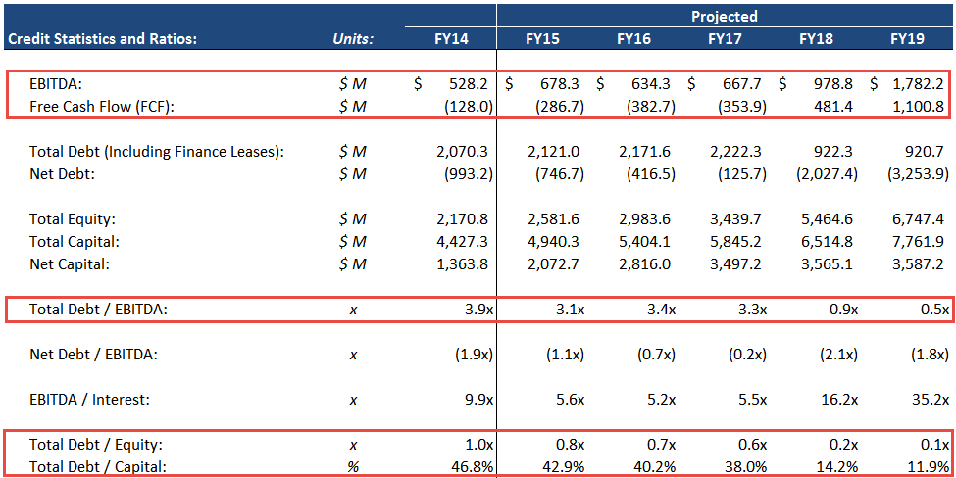
Pro-Forma Credit Statistics and Ratios – Base Case
Because this convertible bond would have a cash settlement option, Nautilus would record its liability and equity components separately, thereby improving its credit stats and ratios:
In the Downside Case, Debt / EBITDA would still rise to 9.5x, but the company’s capital ratios would be in a range more consistent with BB-rated companies
The company’s credit rating might still be downgraded following a convertible bond issuance, but we believe it is less likely than with a traditional Unsecured Senior Note issuance
($ USD in Millions Except for $ per Share Figures)

Slide 13
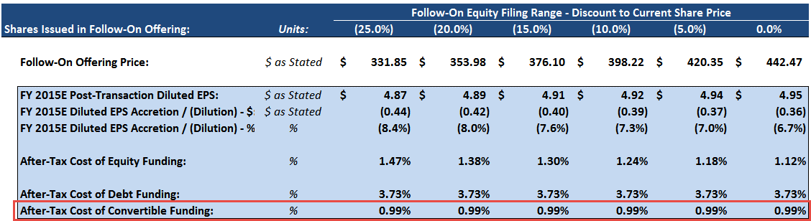
Convertible Bond Funding Costs
The convertible bond would also provide a funding cost advantage, whether funding costs are measured by EPS impact or impact on WACC:
In the WACC calculation, the convertible bond’s after-tax cost of funding is 0.99%, compared with 3.73% for debt or 8.63% – 14.05% for equity
While this cost would increase if the company’s stock price exceeded its conversion price, the company could boost the effective conversion premium to 75% using the call-spread strategy we recommended
($ USD in Millions Except for $ per Share Figures)

Slide 14
Convertible Bond Offering – Conclusions
#1
A Convertible Bond Would Offer the Lowest Cost of Funding
The after-tax cost would range from 0.99% to 1.74%, compared with 3.50% to 4.00% for traditional debt or 1.24% to 1.38% for equity; a convertible bond would also reduce WACC more than either of those
#2
A Convertible Would Let Nautilus Maintain Financial Flexibility
It would have less restrictive covenants than Unsecured Senior Notes, the company’s leverage ratio and capital ratios would remain lower, and the company would be able to raise debt at lower rates in the future
#3
The Convertible’s Market Price Would Be Close to Its Book Value
Assuming that stock-price volatility stays about the same, the convertible bond would likely trade within ~10% of its $1.5 billion book value, reducing risk from short sellers
#4
The Company Could Reduce Dilution with a Call-Spread Structure
While a 45% conversion premium is in-line with recent offerings, the company could boost the effective conversion premium to 75% with purchased call options and sold warrants, reducing economic dilution

